Slide 1
SUSTAINABLE LOGISTICS ANALYTICS
Sustainable Logistics Optimization
Carbon Footprint & Cost Analysis
Leveraging data for ESG performance and operational efficiency

Slide 2
STRATEGIC CONTEXT
ESG & Business Objectives
Analyze, predict, and optimize logistics operations to reduce carbon footprint and improve cost efficiency — directly supporting corporate ESG goals.
KEY ESG FOCUS AREAS
EXPECTED BUSINESS VALUE
Improved brand reputation and stakeholder trust
🌍
Environmental
Greenhouse gas emissions reduction (CO2e) and sustainable resource utilization
Compliance with evolving environmental regulations
⚙
Operational
Realized cost savings through optimized fuel use and operational planning
Enhanced supply chain efficiency and fuel consumption management
Competitive advantage in a sustainability-conscious market
02

Slide 3
METHODOLOGY
Data Acquisition & Feature Engineering
Internal logistics operational data (dummy CSV) — 10 shipments across 19 analyzed metrics.
10
Shipments (rows)
19
Analyzed metrics (columns)
3
Transit modes compared
ORIGINAL KEY FEATURES
ENGINEERED & CALCULATED FEATURES
Shipment_ID, Date, Facility_Type, Urban_Zone
Transit_Mode — primary determinant of emissions (Diesel Truck, Electric Van, Hybrid Van)
Distance_km — distance traveled per shipment
Medical_Payload_kg — weight of goods transported
Traffic_Density_Index — environmental efficiency factor
Actual_Fuel_Liters, Actual_CO2e_kg, Late_Delivery_Flag
Predicted_CO2e_kg — model-generated CO2e emissions
Emissions_Intensity_CO2e_per_kg — CO2e emitted per kg of payload
Carbon_Savings_kg — reduction vs. all-diesel-truck baseline
Actual_Fuel_Cost, Baseline_Fuel_Cost, Estimated_Fuel_Cost_Variance — financial impact metrics
03

Slide 4
MODELING APPROACH
Predictive Modeling
Goal: forecast Actual_CO2e_kg from shipment characteristics using Multiple Linear Regression (Scikit-Learn).
MODEL PERFORMANCE (TEST SET)
INDEPENDENT VARIABLES (PREDICTORS)
R²
MSE
→
Distance_km
~0.38
~2.12
→
Medical_Payload_kg
of variance in actual CO2e explained by the model
avg. squared difference: predicted vs. actual CO2e
→
Traffic_Density_Index
Pipeline note
→
Transit_Mode (one-hot encoded)
Performance reflects a 10-shipment pilot dataset intended to validate the end-to-end pipeline. Accuracy is expected to improve materially as historical shipment volume grows.
Output: model generates Predicted_CO2e_kg per shipment, enabling proactive emissions monitoring.
04

Slide 5
BUSINESS INTELLIGENCE
ESG Reporting: Key Metrics
92.49 kg
95.40 kg
0.0151
Total Predicted Emissions (CO2e)
Total Actual Emissions (CO2e)
Mean Emissions Intensity (kg CO2e / kg payload)
31.14 kg
0.0299
-$15.75
Total Carbon Savings vs. Baseline
Late Delivery vs. High Emission Correlation
Total Estimated Fuel Cost Variance
Late-delivery correlation is very weak — emissions are not a primary driver of delivery timeliness in this dataset.
05

Slide 6
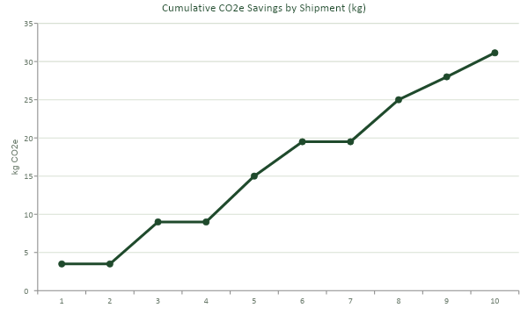
PERFORMANCE VS. ESG TARGETS
Cumulative Carbon Savings Over Time
FINDING
Cumulative carbon savings show a positive, growing trend — demonstrating effective emissions reduction over time, reaching over
31 kg CO2e
in total savings across the 10-shipment pilot.
06

Slide 7
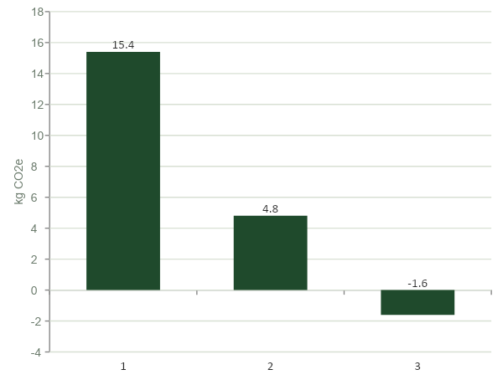
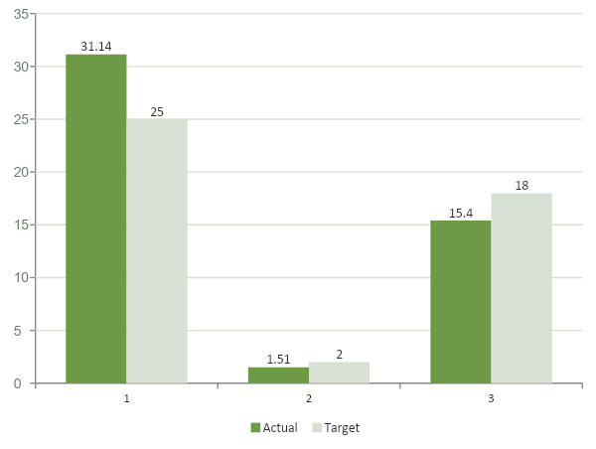
PERFORMANCE VS. ESG TARGETS
Emissions by Transit Mode & ESG Target Attainment
AVG. PREDICTED CO2e EMISSIONS BY SHIPPING MODE
SUSTAINABILITY PERFORMANCE VS. CORPORATE ESG TARGETS
07

Slide 8
KEY TAKEAWAYS
Summary Findings
✓
Achieved Carbon Reductions
⚡
Impact of Transit Mode
Quantifiable carbon savings through strategic logistics choices.
Vehicle type is the most critical factor influencing CO2e — Electric and Hybrid Vans offer significant advantages.
$
Cost Efficiency
★
ESG Target Attainment
Operational changes produced a positive fuel cost variance — economic benefit alongside environmental gain.
Current performance exceeds all set ESG targets, showcasing strong sustainability progress.
⏱
Late Delivery Analysis
Very weak correlation between higher emissions and late deliveries — emissions focus alone won't move delivery timeliness.
08

Slide 9
PATH FORWARD
Recommendations & Next Steps
1
2
3
Strategic Transit Mode Optimization
Maximize Payload Utilization
Continuous ESG Target Setting
Systematically prioritize Electric & Hybrid Vans for feasible routes, especially high-density urban areas and lighter payloads.
Implement advanced load planning and route optimization tools to keep vehicles operating at optimal capacity.
Given current success, revise and set more ambitious targets for emissions, fuel efficiency, and sustainable practices.
4
5
Leverage Advanced Analytics
Proactive Stakeholder Engagement
Integrate real-time data for dynamic route adjustments, predictive maintenance, and sharper emissions forecasting.
Regularly communicate sustainability performance, achievements, and future goals internally and externally.
09

